Slide 1

Effect of Knowledge Distillation Followed by Quantization on Sentiment Preservation of Language Models

Slide 2
Quantization

Slide 3
What is Quantization?
A process that reduces the precision of the model’s parameters, activations, or gradients
Lower memory usage and computational requirements
Represents numbers with lower bits than the standard 64-bit floating point precision, for example 16 bit or even 8-bit numbers.

Slide 4
Why Quantization?
Deploying large models on devices with limited resources
LLMs have been widely adopted but require significant GPU memory for inference.
Reducing the carbon footprint of training and inference processes.

Slide 5
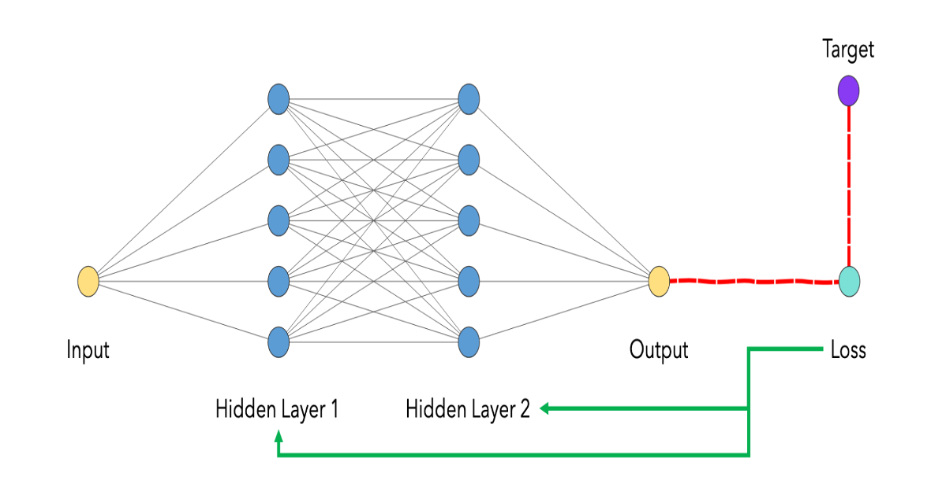
How Quantization Work?
•Neural network made up of many layers
•Linear layers are made up of two matrics : weight and bias
•These layers are represented using floating point #
•Quantization goal is to convert these FP layers into integers

Slide 6
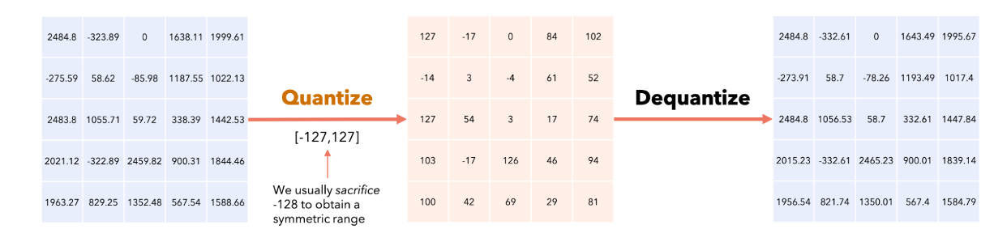
Applying Quantization
•Linear Equation (Y=WX + B)

Slide 7
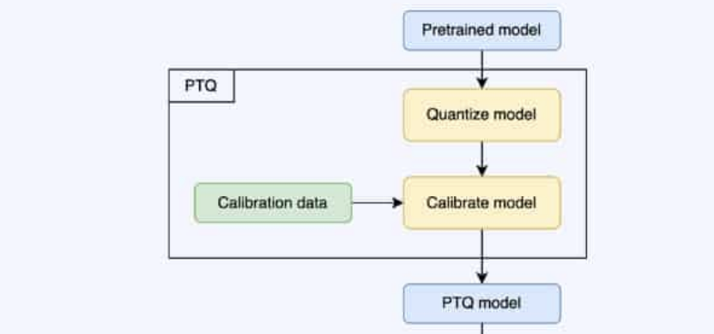
Modes of Quantization
Post-training Quantization
A technique used to quantize a trained model
Training Aware Quantization
A technique used to train models with the awareness of the quantization effects that will be applied during deployment.

Slide 8
Techniques
Basic Techniques:
Uniform
the range of values is divided into equal-sized intervals.
Non-uniform
The range of values is divided into intervals of varying sizes
Advanced Techniques
Dynamic
Converting a model to use a reduced precision integer representation for the weights and/or activations. Calculations are dynamic.
Block-wise
divides input tensors into smaller blocks/chunks/categories that are independently quantized
Mixed Precision
Uses more than one floating-point representation for different parts of the calculations.

Slide 9
Post-Training Quantization
Reduced precision after the initial training of a model.
Focuses on compressing the pre-trained model for deployment on resource-constrained devices.
Less complex compared to QAT since it doesn't require adjustments to the training process.
Result in a loss of model accuracy since any semantics encapsulated in the floating-point values could potentially be lost.
Achieving the right balance between model size reduction and retained accuracy may still involve careful calibration and evaluation

Slide 10
Post-Training Quantization Optimization Methods
Technique | Benefits | Hardware
Dynamic range quantization | 4x smaller, 2x-3x speedup | CPU
Full integer quantization | 4x smaller, 3x+ speedup | CPU, Edge TPU, Microcontrollers
Float16 quantization | 2x smaller, GPU acceleration | CPU, GPU

Slide 11
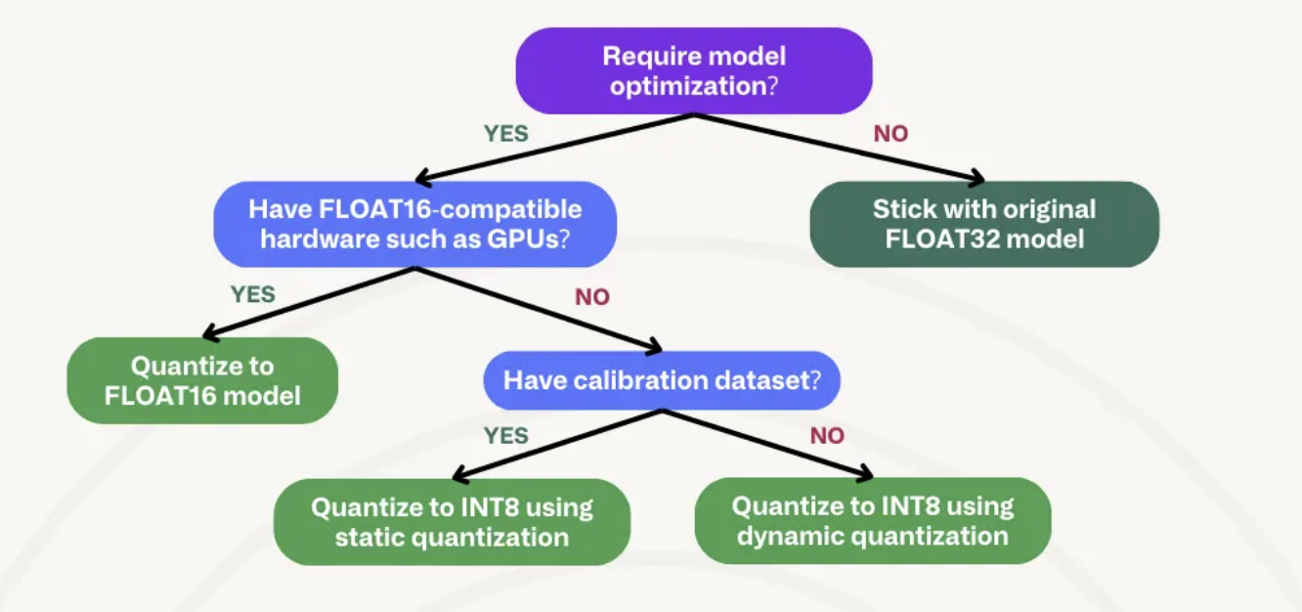
Which Method Should Choose?

Slide 12
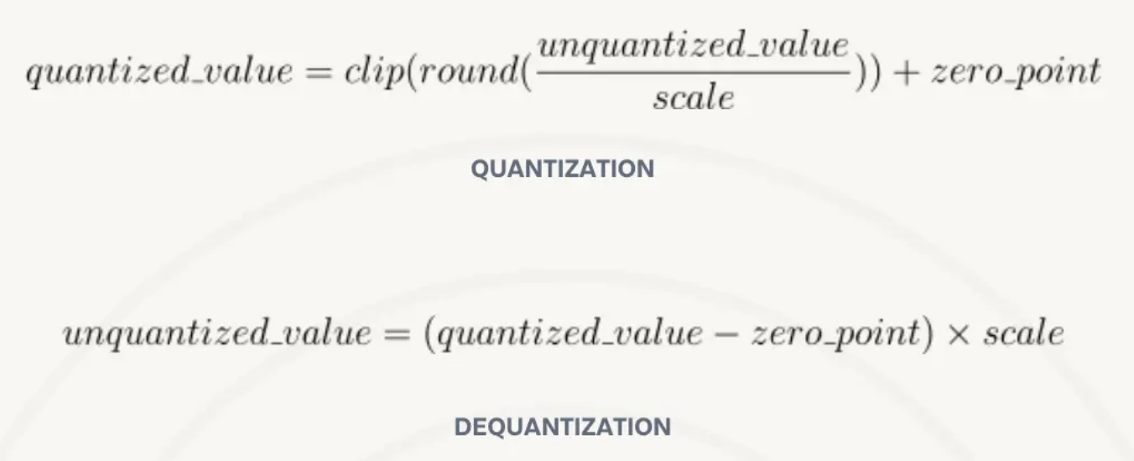
INT8 Quantization
Range of floating-point values are mapped to a quantized (integer) range
[-127, 128] for 8-bit integers.

Slide 13
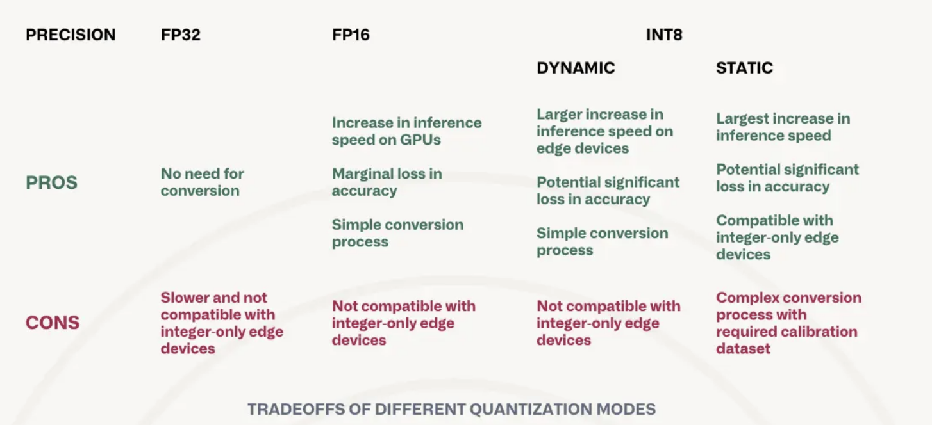
Pros & Cons of Each Model

Slide 14
Knowledge Distillation

Slide 15
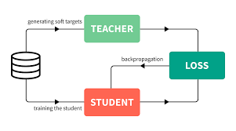
What is Knowledge Distillation?
Teacher Used to Generate Soft Targets.
Student is trained on the Hard.
“Distillation” is used to transfer the knowledge from the cumbersome model to a small model that is more suitable for deployment.

Slide 16

Knowledge Distillation Cont…
Pure class probabilities computed using softmax function.
Higher value for T produces a softer probability distribution over classes.
Fig: Softmax Function

Slide 17
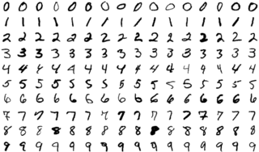
Knowledge Distillation Cont…
Consider MNIST Dataset.
One version of a 2 may be given a probability of 10−6 of being a 3 and 10−9 of being a 7.
It says which 2’s look like 3’s and which look like 7’s.

Slide 18
Experimental Setup
Model: Linear Stack of Neural Network
Dataset: Yelp review
Hardware: Colab CPU

Slide 19
Model Architecture
PARENT MODEL:
Three Fully Connected Linear Layers
Hidden Layer uses Relu activation, Final layer uses Softmax
Total number of parameters = 49,105
Parent(
(linear_relu_stack): Sequential(
(0): Linear(in_features=384, out_features=100, bias=True)
(1): ReLU()
(2): Linear(in_features=100, out_features=100, bias=True)
(3): ReLU()
(4): Linear(in_features=100, out_features=5, bias=True)
(5): Softmax(dim=None)
)
)

Slide 20
Model Architecture
STUDENT MODEL:
Two Fully Connected Linear Layers
Hidden Layer uses Relu activation, Final layer uses Softmax
Total number of parameters = 1,955
~ 4% Size of the PARENT Model
Student(
(linear_relu_stack): Sequential(
(0): Linear(in_features=384, out_features=5, bias=True)
(1): ReLU()
(2): Linear(in_features=5, out_features=5, bias=True)
(3): Softmax(dim=None)
)
)

Slide 21
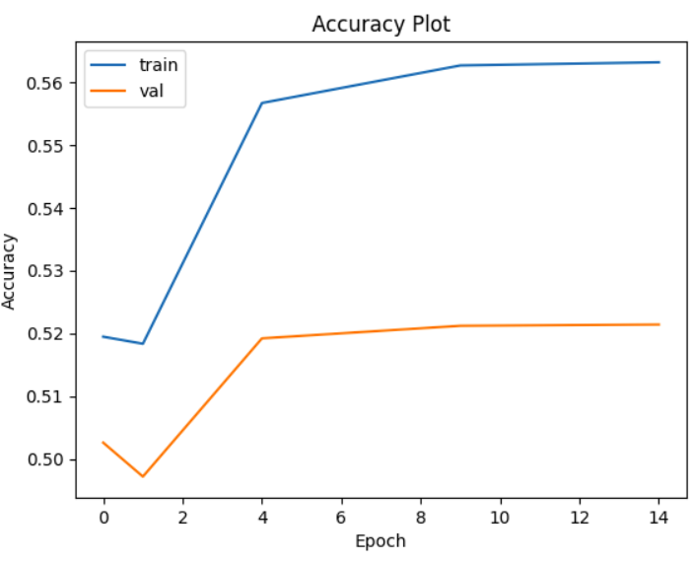
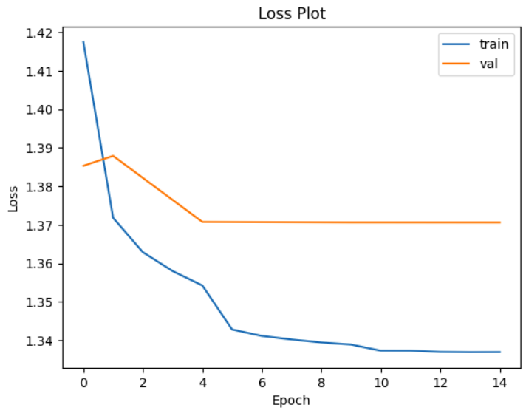
PARENT Performance

Slide 22
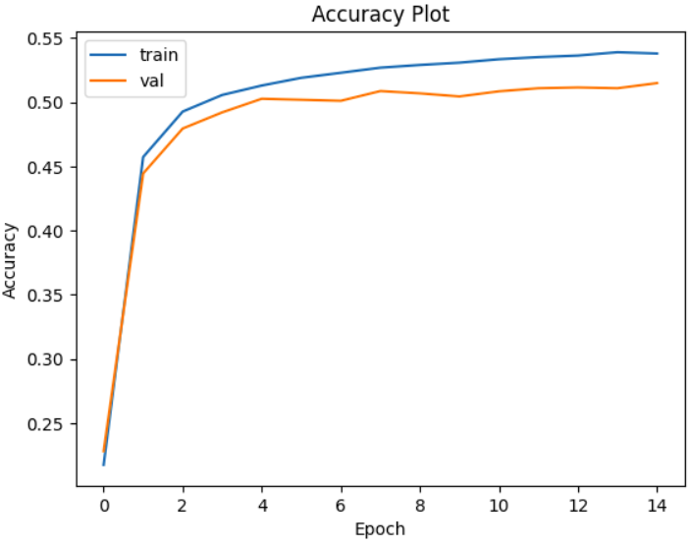
Distilled STUDENT Performance
Slightly decrease in accuracy ~2%
The student model converges faster than the Parent model.
Archives a speed up of 150%
Performance of Quantized Distilled STUDENT Model. ( WIP )

Slide 23
References…
Geoffrey Hinton, Oriol Vinyals, Jeff Dean, Distilling the Knowledge in a Neural Network, 2015
Quantization and Training of Neural Networks for Efficient Integer-Arithmetic-Only Inference, 2017
https://pytorch.org/tutorials/beginner/knowledge_distillation_tutorial.html
https://www.tensorflow.org/lite/performance/post_training_quantization#dynamic_range_quantization
https://www.tensorflow.org/model_optimization/guide/quantization/training
quantization-and-quantization-aware-training
https://huggingface.co/docs/optimum/en/concept_guides/quantization

Slide 24
Directions
Quantization results on distilled model
Try with different model sizes
Different quantization schemes

Slide 25
TAKEAWAY
Compared quantization & distillation on Large Language Models
Impact of different model sized and how much knowledge gets transferred to the student
Effects of combination of distillation & quantization

